Slide 1
MY 3 IDEAS

Slide 2
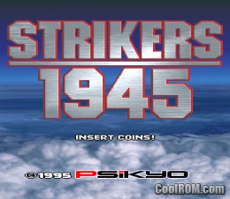
Idea 1 – Simple Vertical Scrolling Shoot’ em up
Inspired by old PSX Shoot’ em up games
Something similar to Striker 1945 and alike
Not as intensive as japanese Bullet Hell Games

Slide 3
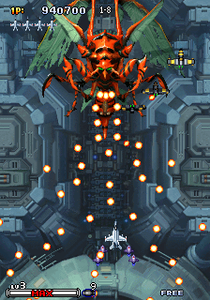
Idea 1’s Concept
Create a fast paced vertical shooter type game
Multiple Enemies appear at the same time
Map/Background is constantly looped over and over again using an seamless image
Most Likely done in processing to reduce lag
All projectiles are going to be particles systems – maybe
There might be sounds

Slide 4
Idea 1’s Concept
For now at most 3 levels, each with their own unique enemies and bosses
Each transition between the menu, levels, etc is a fade out/in effect
Other functions may include, epic music, option for multiplayer, and options to save/load progress

Slide 5
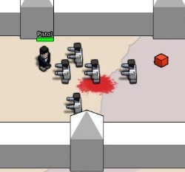
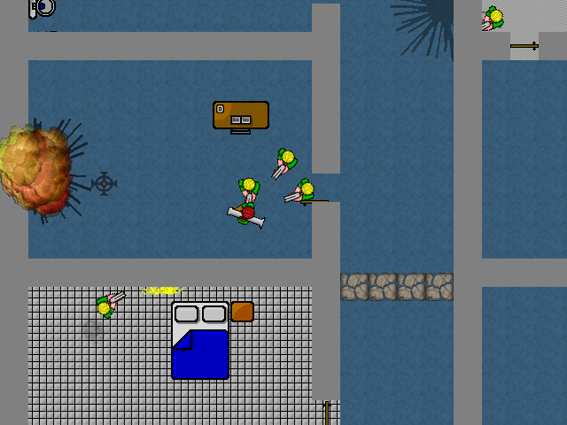
Idea 2 – Top Down RPG/Shooter
Inspired by Top Down Shooters
Such as GTA Chinatown
BoxHead

Slide 6
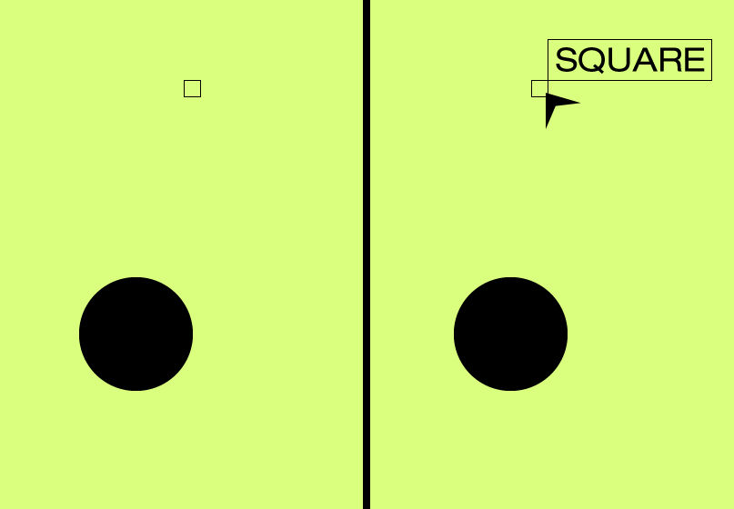
Idea 2 - Concept
A top down RPG or Shooter, Most likely an RPG
A Dialog driven gameplay/Point System
Everything is a top down, 2D
When you hover over objects, their names appear

Slide 7
Idea 1 – Concept RPG Mode
Transitions will be fade out/in
3 different maps
Story – Something similar to CLUE the board game. Multiple endings depending on the options chosen

Slide 8
Idea 2 – Cocenpt Shooter Mode
Enemies/NPC will “Flock” towards the main character
Projectiles will bounce off or disappear when it hits obstacles such as walls, barrels, etc
Point System
5 Stages
Enemies increase the higher you go
Combat Triangle – All certain weapons damage the enemies
Cycle through weapons

Slide 9
Idea 3 Music Player
Upload your own music library
Loop and Shuffle functions along with all the typical music player functions
Some kind of visualization

Slide 10
Idea 3 – Concept
Something simple and runs in the background
Music Player which you can drag and drop files which will update in real time
Accompanied by a simple visualizer - Maybe

